Slide 1
Introduction to Hadoop Distributed File System

Slide 2
Introduction
What is Big Data??
Bulk Amount
Unstructured
Lots of Applications which need to handle huge amount of data (in terms of 500+ TB per day)
If a regular machine need to transmit 1TB of data through 4 channels : 43 Minutes.
What if 500 TB ??
2

Slide 3
What is Hadoop?
Framework for large-scale data processing
Inspired by Google’s Architecture:
– Google File System (GFS) and MapReduce
Open-source Apache project
Nutch search engine project
Apache Incubator
Written in Java and shell scripts

Slide 4
Hadoop Distributed File System (HDFS)
Storage unit of Hadoop
Relies on principles of Distributed File System.
HDFS have a Master-Slave architecture
Main Components:
Name Node : Master
Data Node : Slave
3+ replicas for each block
Default Block Size : 128MB
4

Slide 5
Hadoop Distributed File System (HDFS)
Hadoop Distributed File System (HDFS)
Runs entirely in userspace
The file system is dynamically distributed across multiple computers
Allows for nodes to be added or removed easily
Highly scalable in a horizontal fashion
Hadoop Development Platform
Uses a MapReduce model for working with data
Users can program in Java, C++, and other languages
5

Slide 6
Why should I use Hadoop?
Fault-tolerant hardware is expensive
Hadoop designed to run on commodity hardware
Automatically handles data replication and deals with node failure
Does all the hard work so you can focus on processing data

Slide 7
HDFS: Key Features
Highly Fault Tolerant:
Automatic Failure Recovery System
High aggregate throughput for streaming large files
Supports replication and locality features
Designed to work with systems with vary large file (files with size in TB) and few in number.
Provides streaming access to file system data. It is specifically good for write once read many kind of files (for example Log files).
7

Slide 8
Hadoop Distributed File System (HDFS)
Can be built out of commodity hardware. HDFS doesn't need highly expensive storage devices
– Uses off the shelf hardware
Rapid Elasticity
Need more capacity, just assign some more nodes
Scalable
Can add or remove nodes with little effort or reconfiguration
Resistant to Failure
Individual node failure does not disrupt the system
8

Slide 9










Who uses Hadoop?

Slide 10
What features does Hadoop offer?
API and implementation for working with MapReduce
Infrastructure
Job configuration and efficient scheduling
Web-based monitoring of cluster stats
Handles failures in computation and data nodes
Distributed File System optimized for huge amounts of data

Slide 11
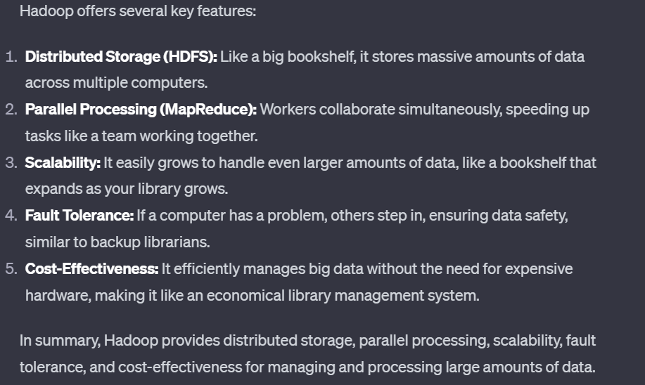

Slide 12
When should you choose Hadoop?
Need to process a lot of unstructured data
Processing needs are easily run in parallel
Batch jobs are acceptable
Access to lots of cheap commodity machines

Slide 13
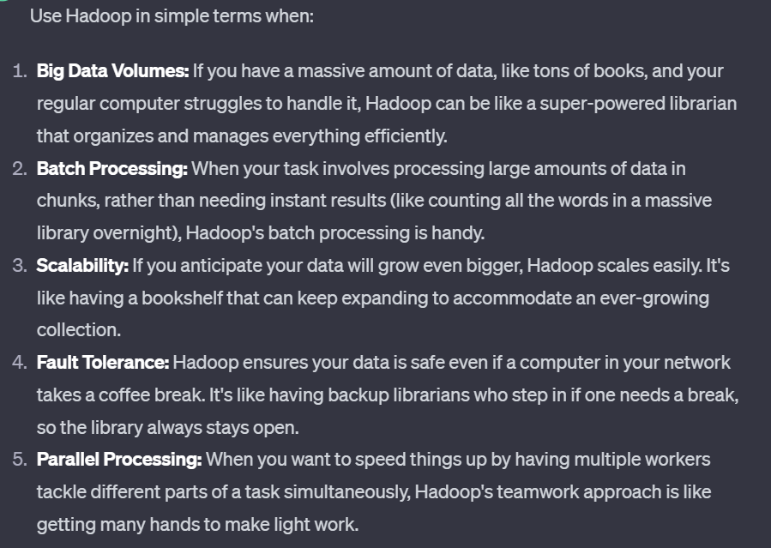
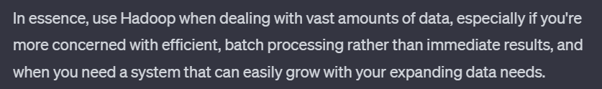

Slide 14
When should you avoid Hadoop?
Intense calculations with little or no data
Processing cannot easily run in parallel
Data is not self-contained
Need interactive results

Slide 15
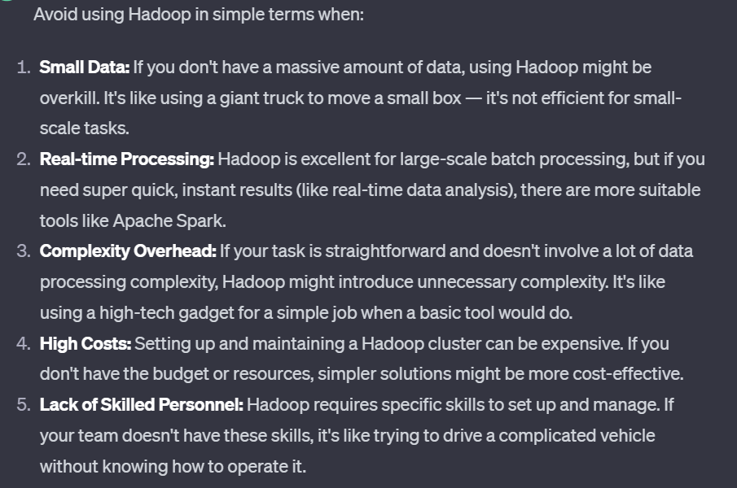
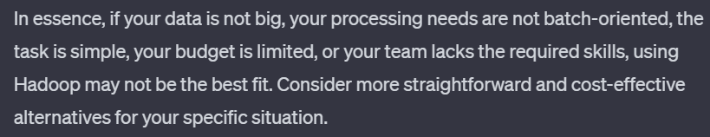

Slide 16
Hadoop Examples
Hadoop would be a good choice for:
Indexing log files
Sorting vast amounts of data
Image analysis
Search engine optimization
Analytics
Hadoop would be a poor choice for:
Calculating Pi to 1,000,000 digits
Calculating Fibonacci sequences
A general RDBMS replacement

Slide 17
Hadoop Distributed File System (HDFS)
How does Hadoop work?
Runs on top of multiple commodity systems
A Hadoop cluster is composed of nodes
One Master Node
Many Slave Nodes
Multiple nodes are used for storing data & processing data
System abstracts the underlying hardware to users/software
14

Slide 18
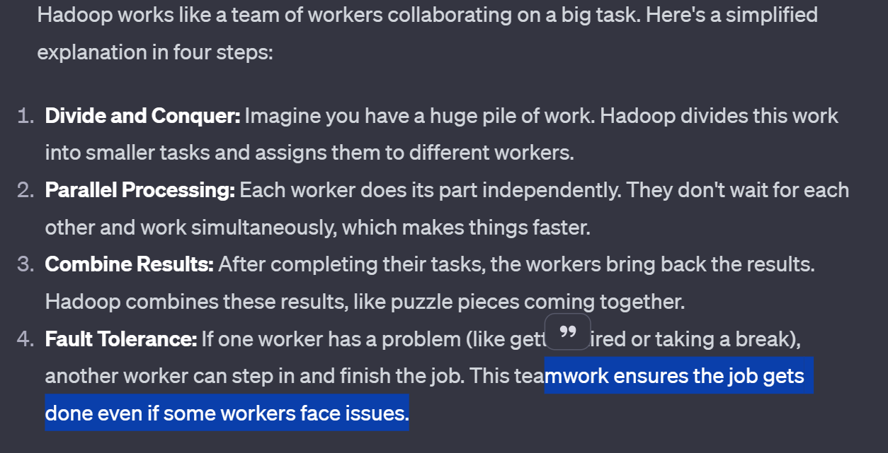
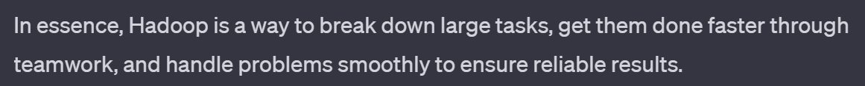

Slide 19
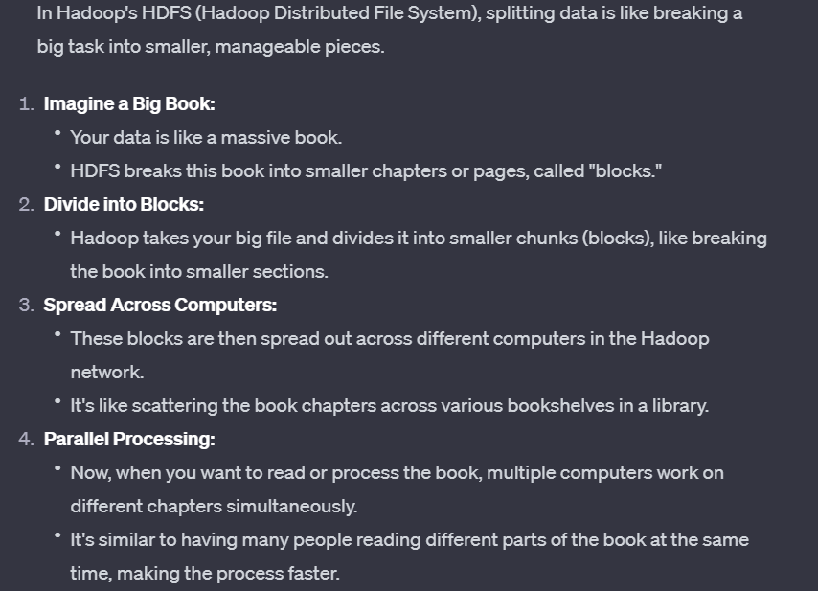
How HDFS works: Split Data

Slide 20
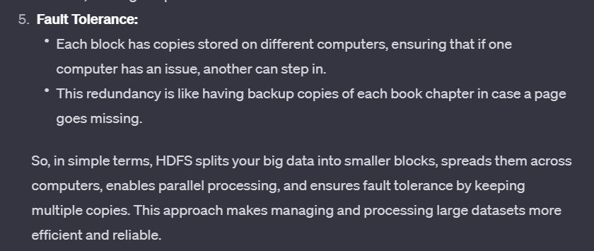
How HDFS works: Split Data

Slide 21

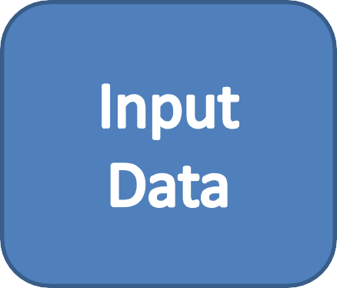


How HDFS works: Split Data
Data copied into HDFS is split into blocks
Typical HDFS block size is 128 MB
– (VS 4 KB on UNIX File Systems)

Slide 22
How HDFS works: Replication
Each block is replicated to multiple machines
This allows for node failure without data loss
Block #1
Block #2
Block #1
Data Node 1
Data Node 2
Block #3
Data Node 3
Block #2
Block #3

Slide 23

HDFS Architecture

Slide 24
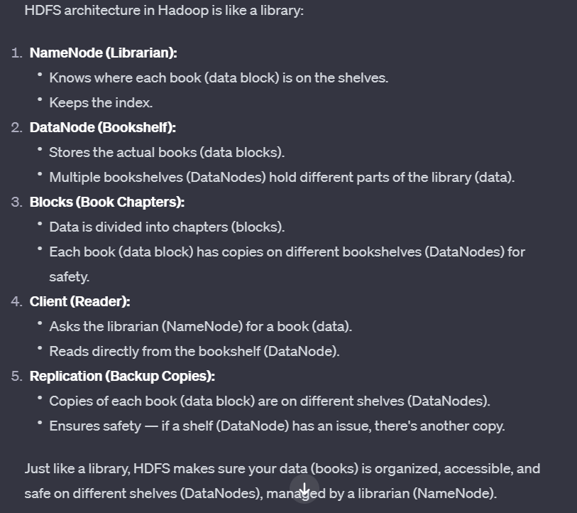
HDFS Architecture

Slide 25

























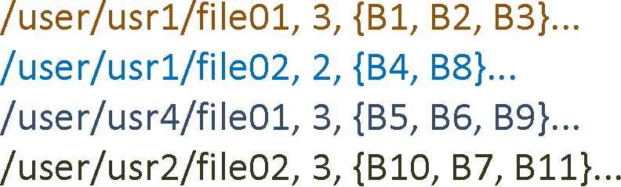






Hadoop Distributed File System (HDFS)
HDFS is a multi-node system
Name Node (Master)
Single point of failure
Data Node (Slave)
Failure tolerant (Data replication)
HDFS Consists of data blocks
Files are divided into data blocks
Default size: 128MB
Default Replication of blocks: 3
Blocks are spread out over Data Nodes
18

Slide 26
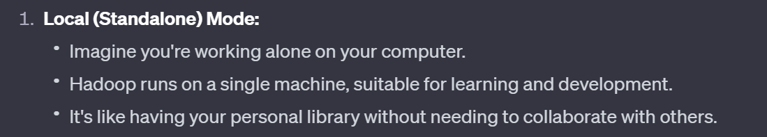
Hadoop Modes of Operation
Hadoop supports three modes of operation:
Standalone
Pseudo-Distributed
Fully-Distributed

Slide 27
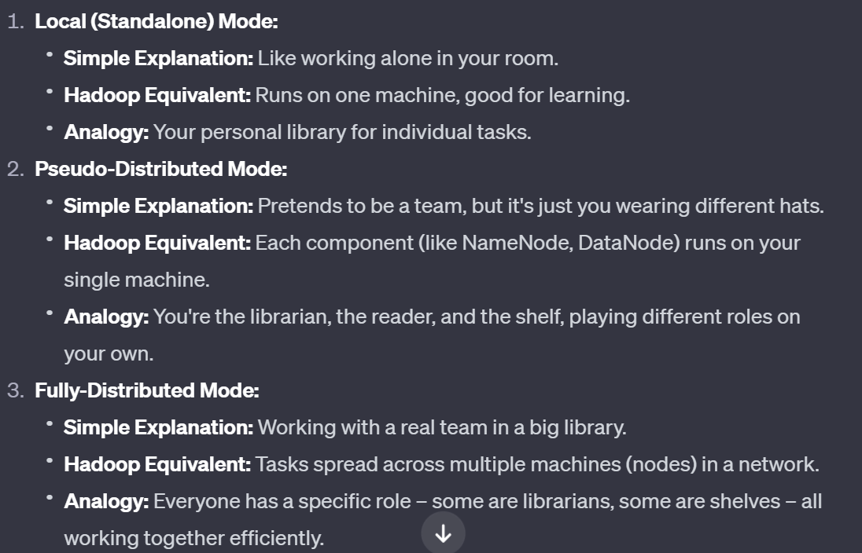
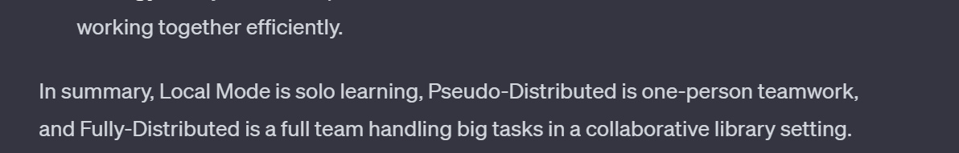
Hadoop Modes of Operation

Slide 28


Hadoop Architecture Overview
Client
Job Tracker
Name Node
Task Tracker
Task Tracker
Data Node
Data Node
Data Node
Data Node

Slide 29
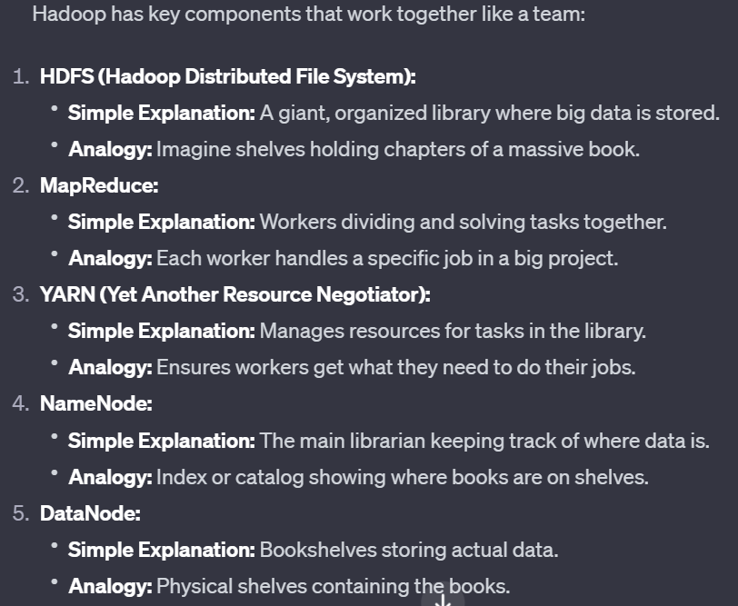



Hadoop Components: Job Tracker
Job Tracker
Name Node
Task Tracker
Data Node
Data Node

Slide 30
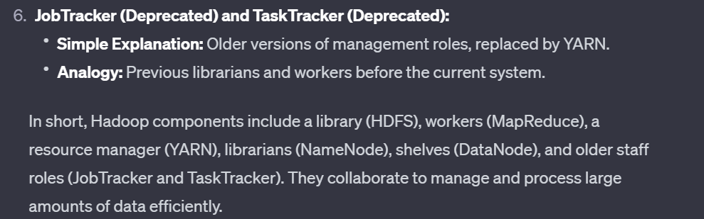
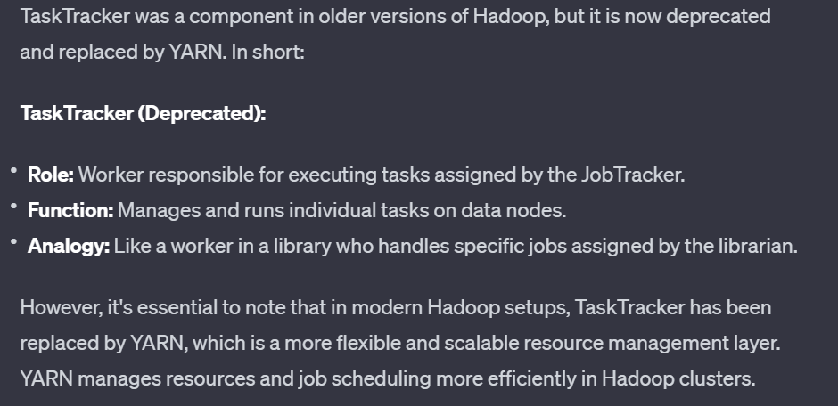
Hadoop Components: Job Tracker
Job Tracker
Name Node
Task Tracker
Data Node
Data Node

Slide 31


Hadoop Components: Job Tracker
Client
Job Tracker
Name Node
Task Tracker
Task Tracker
Data Node
Data Node
Data Node
Data Node
Only one Job Tracker per cluster
Receives job requests submitted by client
Schedules and moniSStCohurnsg CIjSo61b2 LsectourenNotteas sk trackers

Slide 32

Hadoop Components: Name Node
Client
Job Tracker
Name Node
Task Tracker
Task Tracker
Data Node
Data Node
Data Node
Data Node
One active Name Node per cluster
Manages the file system namespace and metadata
Single point of failure: Good place to spend money on hardware

Slide 33
Name Node
Master of HDFS
Maintains and Manages data on Data Nodes
High reliability Machine (can be even RAID)
Expensive Hardware
Stores NO Data; Just holds Metadata!
Active & Passive Name Nodes from Gen2 Hadoop
Secondary Name Node in Gen2:
– Reads from RAM of Name Node and Stores it to hard disks periodically.
23

Slide 34


Hadoop Components: Task Tracker
Client
Job Tracker
Name Node
Task Tracker
Task Tracker
Data Node
Data Node
Data Node
Data Node
There are typically a lot of Task Trackers
Responsible for Executing of Mappers & Reducers
Reads blocks of data from data nodes

Slide 35




Hadoop Components: Data Node
Client
Job Tracker
Name Node
Task Tracker
Task Tracker
Data Node
Data Node
Data Node
Data Node
There are typically a lot of data nodes
Data nodes manage data blocks and serve them to clients
Data is replicated so failure is not a problem

Slide 36
Data Nodes
Slaves in HDFS
Provides Data Storage
Deployed on independent machines
Responsible for serving Read/Write requests from Client.
The data processing is done on Data Nodes.
26

Slide 37
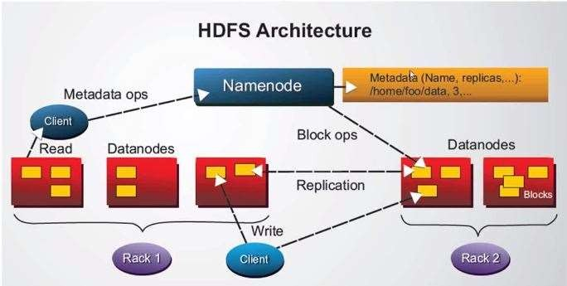
HDFS Architecture
27

Slide 38
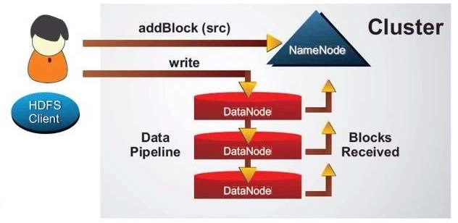
HDFS Operation
28

Slide 39
HDFS Operation
Client makes a Write request to Name Node
Name Node responds with the information about on available data nodes and where data to be written.
Client write the data to the addressed Data Node.
Replicas for all blocks are automatically created by Data Pipeline.
If Write fails, Data Node will notify the Client and get new location to write.
If Write Completed Successfully, Acknowledgement is given to Client
Non-Posted Write by Hadoop
29

Slide 40
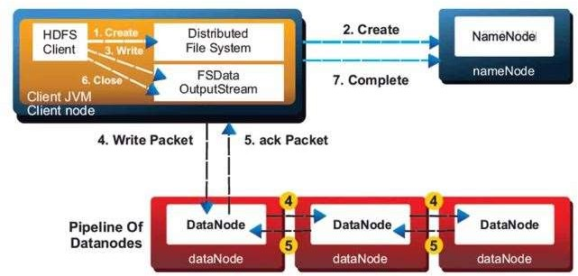
HDFS: File Write
30

Slide 41
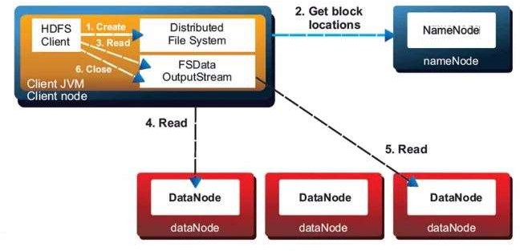
HDFS: File Read

Slide 42
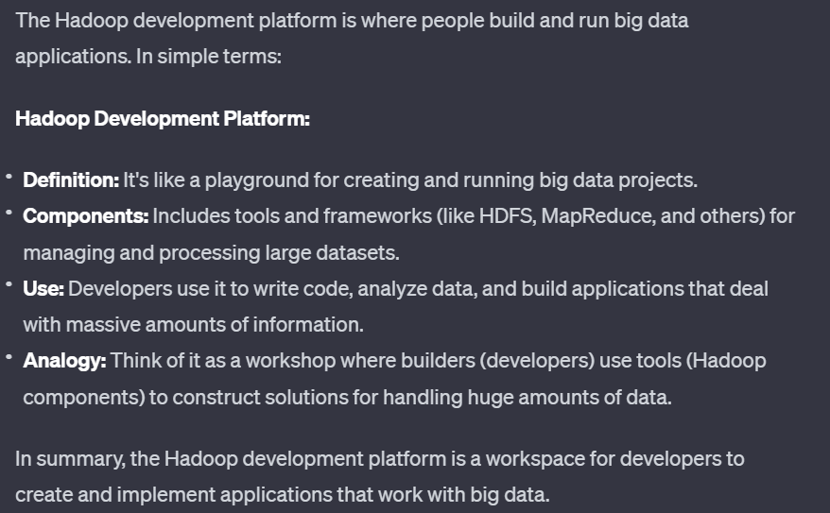




Hadoop Development Platform

Slide 43
Hadoop Development Platform
User written code runs on system
System appears to user as a Single Entity
User does not need to worry about Distributed system
Many system can run on top of Hadoop
Allows further abstraction from system

Slide 44
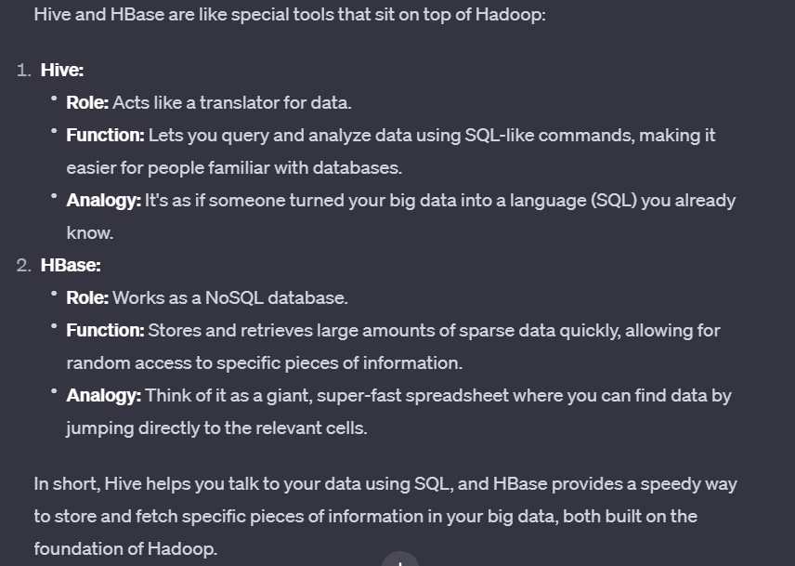
Hive and HBase are layers on top of Hadoop

Slide 45






◆ Hive and HBase are layers on top of Hadoop
HBase & Hive are applications
Provide an interface to data on the HDFS
Other programs or applications may use Hive or HBase as an intermediate layer
ZooKeeper
HBase

Slide 46
Hive
Data Warehousing application
SQL like commands (HiveQL)
Not a traditional relational database
Scales horizontally with ease
Supports massive amounts of data*
* Facebook has more than 15PB of information stored in it and imports 60TB each day (as of 2010)

Slide 47
HBase
No SQL Like language
Uses custom Java API for working with data
Modeled after Google’s BigTable
Random read/write operations allowed
Multiple concurrent read/write operations allowed

Slide 48
Hadoop has it’s own implementation of MapReduce
Hadoop 1.0.4
API: http://hadoop.apache.org/docs/r1.0.4/api/
Tutorial: http://hadoop.apache.org/docs/r1.0.4/mapred_tutorial.html
Custom Serialization Data Types
Writable/Comparable
Text vs String LongWritable vs long IntWritable vs int DoubleWritable vs double

Slide 49
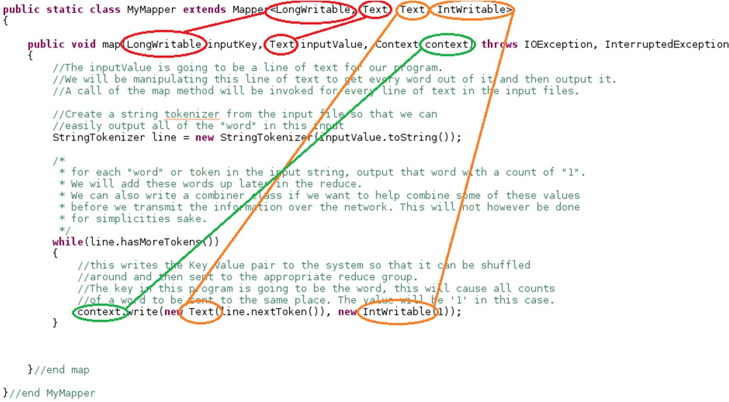

Slide 50
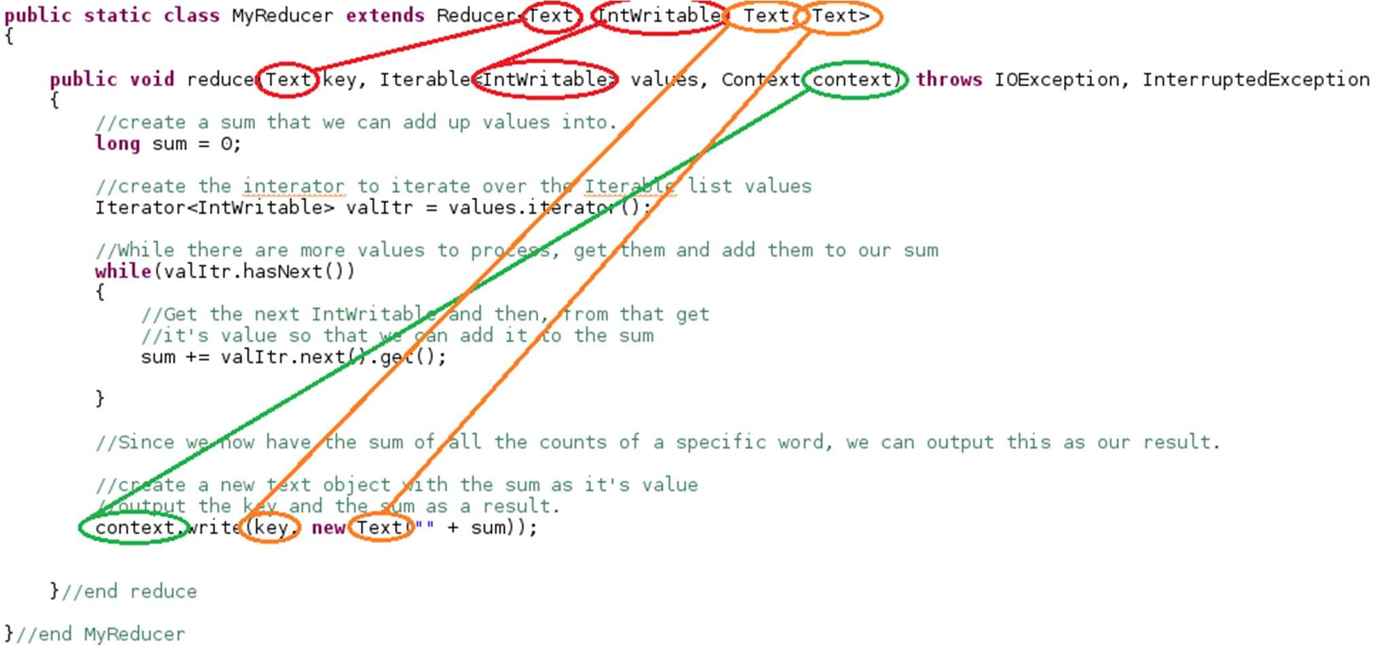

Slide 51
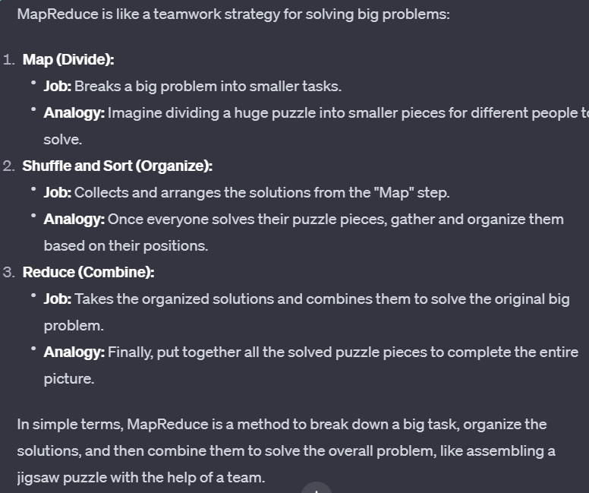
MapReduce Job

Slide 52
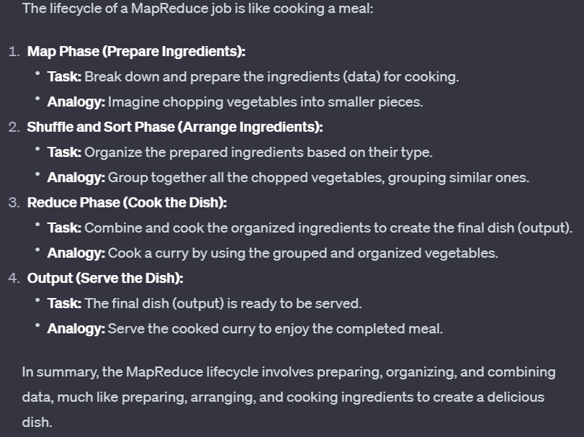
Lifecycle of a MapReduce Job

Slide 53
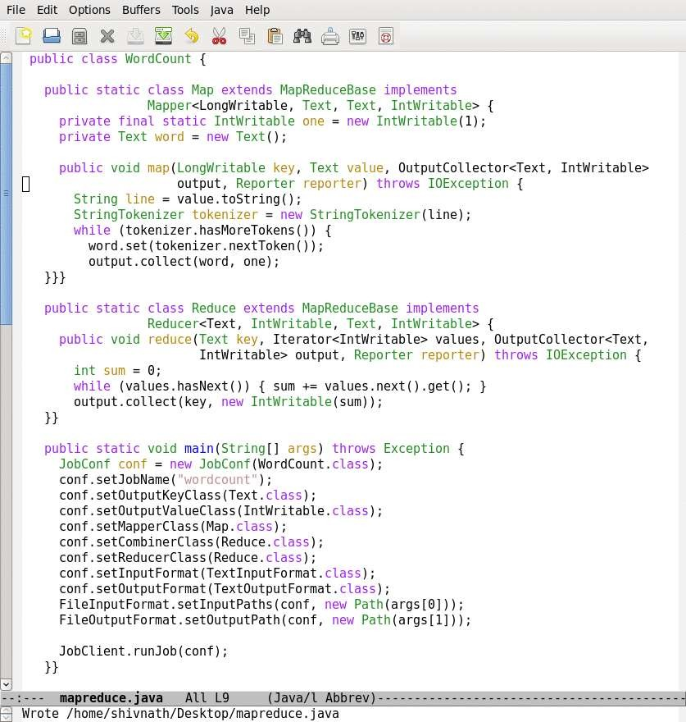
Lifecycle of a MapReduce Job
Map function
Reduce function
Run this program as a MapReduce job

Slide 54
Working with the Hadoop
http://hadoop.apache.org/docs/r1.0.4/commands_manual.html
A quick overview of Hadoop commands
bin/start-all.sh
bin/stop-all.sh
bin/hadoop fs –put localSourcePath hdfsDestinationPath
bin/hadoop fs –get hdfsSourcePath localDestinationPath
bin/hadoop fs –rmr folderToDelete
bin/hadoop job –kill job_id
Running a Hadoop MR Program
bin/hadoop jar jarFileName.jar programToRun parm1 parm2…
40

Slide 55
Useful Reference Sites
http://wiki.apache.org/hadoop/EclipsePlugIn
10gen. Mongodb. http://www.mongodb.org/
Apache. Cassandra. http://cassandra.apache.org/
Apache. Hadoop. http://hadoop.apache.org/
Apache. Hbase. http://hbase.apache.org/ [6] Apache, Hive. http://hive.apache.org/ [7] Apache, Pig. http://pig.apache.org/
[8] Zoo Keeper, http://zookeeper.apache.org/
41

